Slide 1
MINI PROJECT FACE MASK DETECTION
DONE BY:
MRITHIKA.G.R (1931024)

Slide 2
PROJECT ABSTRACT
Studies have shown that wearing a face mask decreases the risk of viral transmission substantially as well as offers a sense of security.
However, monitoring the implementation of this policy manually is not feasible. Here, technology holds the key. An important and economic approach to the use of AI to build a stable approach In a production setup, the setting
A hybrid model using For face mask detection, deep and classical machine learning It will be sent. A dataset of face mask detection consists of With mask and without mask images, we will use To do real-time face detection from a live stream via OpenCV With our webcam.
To build a COVID-19 face, we will use the dataset to Computer vision mask detector. Our goal is to decide whether the Wearing a face mask or not is a person on the image/video stream.

Slide 3

LANGUAGES USED
KERAS
PYTHON
OPENCV

Slide 4
KERAS
Keras is an Open Source Neural Network library written in Python that runs on top of Theano or Tensorflow. It is designed to be modular, fast and easy to use.
Keras is high-level API wrapper for the low-level API, capable of running on top of TensorFlow, CNTK, or Theano.
Keras High-Level API handles the way we make models, defining layers, or set up multiple input-output models. In this level, Keras also compiles our model with loss and optimizer functions, training process with fit function.
Keras in Python doesn't handle Low-Level API such as making the computational graph, making tensors or other variables because it has been handled by the "backend" engine.

Slide 5
OPEN CV
OpenCV ( Open Source Computer Vision Library) is a library of programming functions mainly aimed at real-time computer vision.
Originally developed by Intel, it was later supported by Willow Garage then Itseez (which was later acquired by Intel ).

Slide 6
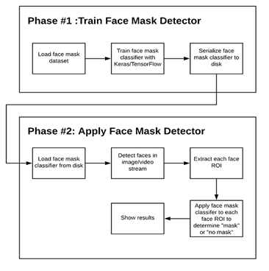
Two-phase COVID-19 face mask detector
PHASE 1
Notes
PHASE 2
Load face mask dataset.
Train face mask classifier with keras.
Serialize face mask classifier to disk
Watch today’s documentary
Bake c-rolls for tomorrow’s gathering
Call Samantha and gossip a little
Buy Arantxa’s books
Load face mask classifier from disk
Detect faces in video stream
Extract each face region of interest(ROI)
Apply face mask classifier to determine “mask” or “no mask”
Plan trip with high school friends
Get a massage for my neck ache
Read Marian’s tweets of the day

Slide 7
FACE MASK DETECTOR
We use Python script to train a face mask detector and review the results.
Given the trained COVID-19 face mask detector, proceed to implement two more additional Python scripts used to:
Detect COVID-19 face masks in images
Detect face masks in real-time video streams

Slide 8
Thank you!

